Slide 1
AZERBAIJAN STATE OIL AND INDUSTRY UNIVERSITY
Subject: English
Faculty: ITIF
Group:604.20E
Teacher: Yelena Valiyeva
Student: Gunel Humbatova

Slide 2
Some notes about Europian Countries
Design by gnl

Slide 3
PLAN
SOME FACTS ABOUT EUROPE
FRANCE
SPAIN
Italy
Germany
Europe

Slide 4
LARGEST COUNTRY:
760,000
RUSSIA
RELIGIONS
950,000
CHRISTIANITY, ISLAM
1,000,000
LARGECT CITY
ISTANBUL
POPULAR COUNTRIES
FRANCE, SPAIN, UK, ITALY, GERMANY
Notes:
Europe, second smallest of the world’s continents and occupying nearly one-fifteenth of the world’s total land area. The Name Europe Comes from Greek. There Are 50 Countries in Europe

Slide 5
FRANCE
FRANCE IS THE MOST VISITED COUNTRY IN THE WORLD
DUE TO THE SIX-SIDED SHAPE OF THE COUNTRY, IT’S ALSO CALLED “THE HEXAGON”
FRANCE’S NATIONAL MOTTO IS “LIBERTY, EQUALITY AND FRATERNITY”
FRANCE IS HOME TO THE WORLD’S INFLUENTIAL THINKERS AND WRITERS
FRANCE
Bonjour
Bon Apetit
Madame
Notes:
France is a known tourist destination across the world, especially for those who are into romantic places. Its beautiful chateaus, towers, and architectures make the country a perfect place to explore new things while meeting new people. More than their love for wine and cheese, this incredible country has a very rich culture and history that will make you fall in love with it over and over again.
You can marry dead people in France.
One of the least known France facts is that in French law, there are cases where you can marry a person even after their death. The country simply requires proof that the dead had a legitimate intention to marry when they were alive. After this is confirmed, the French President will then approve the marriage.

Slide 6
SPAIN
Spain was founded in 1512.
2.The national anthem of Spain does not have words.
3.Spain has a population of 46.7 million.
Notes:
Among the many things that Spain is famous for are its Flamenco music and dance. Other things on the list are architecture, art, bullfights, food, horses, its islands, literature, its Moorish heritage, wines, and soccer (futbol). The national capital of Spain is Madrid. This city is best known for its winding streets, and renowned museums and bookstores. Aside from being the largest city in Spain, Madrid also serves as the financial and cultural center of the country. Spanish is widely used in 22 countries.
They are as follows: Argentina, Bolivia, Chile, Colombia, Costa Rica, Cuba, Dominican Republic, Ecuador, El Salvador, Equatorial Guinea, Guatemala, Honduras, Mexico, Nicaragua, Panama, Paraguay, Peru, Puerto Rico, Spain, Uruguay, Venezuela, and Western Sahara. Spanish is the third most commonly used language in the world.
Coming after Mandarin and English, there are more than 470 million Spanish speaking people in world.

Slide 7

ITALY
The name Italy originated from the word ‘Italia’ which means ‘calf land.’
60%
Rome is Italy's capital city.
People also call Rome the Eternal City since it’s already 3,000 years old. Established in 1871, Rome is the biggest city in the country and is home to numerous landmarks such as the Trevi Fountain and the Colosseum.
35%
Lily is the national flower of Italy.
Notes:
Aside from pasta and Ferraris, Italy has made a name for itself in many ways. This boot-shaped country pioneers industries such as food, fashion, and luxury cars, as well as sports. Italy’s history, culture and arts shaped the world as we know it today.
Italy is also known for its universal brands.
Italy’s celebrated designers include Armani, Gucci, Prada, and Versace. Even in the fine sports cars category, Italy also holds the bragging rights to Ferrari and Lamborghini.

Slide 8
Germany
Germany has a population of 81 million people.
75%
One-third of Germany is still covered in forests and woodlands.
35%
90%
There are over 2100 castles in Germany.
50%
Donaudampfschifffahrtselektrizitätenhauptbetriebswerkbauunterbeamtengesellschaft is the longest word to be published. It is 79 letters long.
Notes:
Germany is known for a lot of things.
Free-tuition universities, high-quality education, and cultural diversity are some of the highlights.
The Christmas tree (Tannenbaum) tradition came from Germany.
University is free for everyone (even non-Germans).

Slide 9
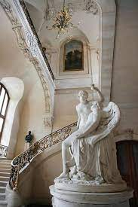
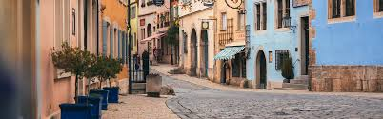
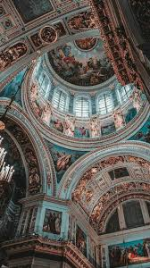
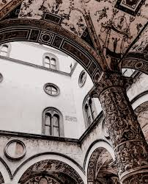
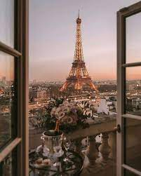
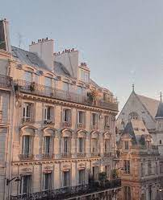
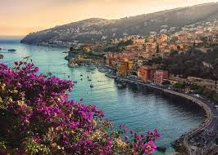
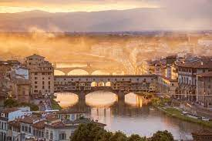
EUROPE
Notes:
The travels of Europe are both tiring and exciting. From beautiful scenery to historic monuments and buildings, Europe is considered the pinnacle of art and history by many.
Austria, France, England, Germany, Italy, and Spain are and were powerful countries with hundreds of years of accumulated historic wealth and I really wanna see some of the many sights of Europe.

Slide 10
THANK YOU FOR YOUR ATTENTION

